Slide 1
B.Tech. II (CSE) Semester – IV DESIGN AND ANALYSIS OF ALGORITHMS (CORE-7) CS206

Slide 2
Introduction
How to define Algorithm?
Algorithm is a systematic logical approach used to solve problems in computer.
An abstract computational procedure which takes some values as input and produces a value or values as output.
Algorithm is a finite set of instructions that can be used to achieve a particular task.

Slide 3
Algorithm Vs Pseudocode
Algorithm:
Is an executable code logic defines by a sequence of sets to solve a problem or computer task.
Unlike pseudocode, the person writing an algorithm needs programming language knowledge because it is interpreted by computer.
Algorithm has noting to do with programming language.
Pseudocode:
a more simple form of an algorithm which involves some part of natural language to enhance the understandability of the high-level programming constructs or for making it more human-friendly.
is not an executable code, so not mandatory to use exact programming syntax. However it is widely used standard in the industry, which can be easily understood by solution team.

Slide 4
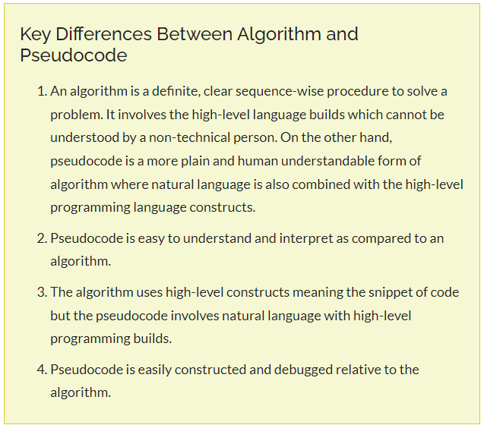
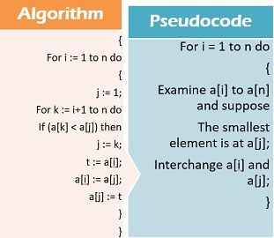
Algorithm Vs Pseudocode

Slide 5
Certain Criteria to followed by algorithm
Input: There must be zero or more quantities that are externally supplied.
Output: algorithm must produce at least one output. The algorithms that does not produce any output is useless.
Finiteness: means that the algorithm must have the ending. It should not keep on running in a infinite way.
Definiteness: means there must be clear and unambiguous statements, i.e. every statement in a algorithm must not give two meaning, one statement should mean only one thing.
Effectiveness: every instruction must be so clear that we could implemented with simply with the help of pen and paper and it should not be complex. If problem is big then it is divided into smaller parts and there are various way to study the algorithm which help you to solve every complex problem in simple and normal way.

Slide 6
Properties of an algorithm
Independent of the programming languages
There should be no infinite loop, if there is infinite loop then “finiteness” would not be fulfilled.
An algorithm is the sequence of operations performed on the data and data is organised in data structure.
An algorithm is said to be correct if, for every input instance, it halts with the correct output.
We say that a correct algorithm solves the given computational problem.
An incorrect algorithm might not halt at all on some input instances, or it might halt with an incorrect answer.
Contrary to what you might expect, incorrect algorithms can sometimes be useful, if we can control their error rate. We shall see an example of an algorithm with a controllable error rate, when we study algorithms for finding large prime numbers.
Ordinarily, however, we shall be concerned only with correct algorithms.

Slide 7
Prerequisites of this course
Familiar with some programming
Data structure
A data structure is a way to store and organize data in order to facilitate access and modifications. No single data structure works well for all purposes, and so it is important to know the strengths and limitations of several of them.
Discrete mathematics background
Discrete mathematics is the study of mathematical structures that are fundamentally discrete rather than continuous. In contrast to real numbers that have the property of varying "smoothly", the objects studied in discrete mathematics – such as integers, graphs, and statements in logic – do not vary smoothly in this way, but have distinct, separated values.

Slide 8
Hard Problems
Most of the algorithms are about efficient algorithms. Our usual measure of efficiency is speed, i.e., how long an algorithm takes to produce its result. There are some problems, however, for which no efficient solution is known.
Why are NP-complete problems interesting?
First, although no efficient algorithm for an NP-complete problem has ever been found, nobody has ever proven that an efficient algorithm for one cannot exist. In other words, no one knows whether or not efficient algorithms exist for NP-complete problems.
Second, the set of NP-complete problems has the remarkable property that if an efficient algorithm exists for any one of them, then efficient algorithms exist for all of them.

Slide 9
Hard Problems contd..
As a concrete example,
consider a delivery company with a central depot. Each day, it loads up each delivery truck at the depot and sends it around to deliver goods to several addresses. At the end of the day, each truck must end up back at the depot so that it is ready to be loaded for the next day.
To reduce costs, the company wants to select an order of delivery stops that yields the lowest overall distance traveled by each truck.
This problem is the well-known “traveling-salesman problem,” and it is NP-complete.
It has no known efficient algorithm. Under certain assumptions, however, we know of efficient algorithms that give an overall distance which is not too far above the smallest possible.

Slide 10
Fundamental questions
Given a certain problem, how do you solve it with computer?
Is it relatively easy to design an algorithm that some how solve many problems?
However quite of cleverness is needed to design an algorithm that are also fast. This will be a major challenge in the course.
There can be scope of multiple solutions for a single problem:
Finding the GCD,
school level factorization algorithm, if m=36 and n=48; m= 2*2*3*3, n=2*2*2*2*3; what factors are common, 2,2,3; GCD=?
Euclid algorithm, invented by mathematician
Sorting the set of elements etc…

Slide 11
Fundamental questions contd….
Euclid Algorithm:
Euclid (m, n)
while m does not divide n
r=n mod m;
n= m;
m=r;
end
return m;

Slide 12
Compare these two algorithms
m=36, n=48
m= 2*2*3*3 // how many factors? How many divisions?
n= 2*2*2*2*3 // total no divisions?
For Euclid: How many divisions?
Which one is efficient?

Slide 13
complexity
Complexity is the parameter that defines how much our algorithm is efficient?
Space complexity: how much memory the algorithm is taking in the system and
Time complexity: how much time it is taking to execute
Space complexity: 1) fixed part, 2) variable part
Fixed part: some of the variables, suppose we have to find sum of two numbers, so we already defined in the program, a and b, they occupy spaces in the memory.
Variable part: when we have dynamic allocation of memory, i.e. we initially don’t know how much memory algorithm will take?

Slide 14
Complexity contd…
Time complexity: 1) compile time, 2) run time
Compile time: how much time the program takes to compile? And in most of the cases, it is constant value.
Run time: it depends on algorithm to algorithm, ex: suppose user wants to print nos 1----n, and n is entered by the user. For n=5, so program takes one unit of time for one for loop so it will take 5 unit of time.

Slide 15
Example: time complexity
Sum (a , n)
{
s=0;
for int i=1 to n do //if n=5 total time complexity=?
s=s+a[i];
return s;
}

Slide 16
Asymptotic Notations

Slide 21
Some information
O is for worst case time or the upper bound, which means if you are giving any time in terms of O, it also saying that in any case your time will not exceed this.
If you are giving your time in case of Ω, it gives best case which means in any case you can never achieve better than this.
In practice, we are not interested in what is the best time the algo could execute. We always interested in what is the worst case time that will be taken by the algorithm for any input.
When to use average case?
When worst case and best case both are same. For some algorithm the worst case and best case both will be same, so for any input algorithm will take same time.

Slide 22
Some example- complexity analysis
Assume that we have an array of numbers.
Task: search an element.
Here linear search algorithm: take x and compare with first to last element of an array.
What is the best case time we could execute this algorithm?
In best case we can search the element in one comparison, i.e. in one step. Therefore for best case time= Ω (1)
That means in best case, we can find out the element in just one comparison or in one step.
What is the worst case time?

Slide 23
Some example contd…
If I have n element in the array and searching for element x, then in worst case, I have to compare with n elements.
Therefore in worst case O (n)- you can never go beyond this

Slide 24
Some example contd…
Time complexity | Name | Example
O(1) | Constant | Adding one element to front of the linked list
O(logn) | logarithmic | Finding an element in a sorted array
O(n) | linear | Finding an element in unsorted array
O(nlogn) | Linear logarithmic | Merge sort
O(n² ) | Quadratic | Shortest path between two nodes in a graph
O(n³ ) | Cubic | Matrix multiplication
O(2^{n} ) | Exponential | Towers of Hanoi problem

Slide 25
Complexity analysis of binary search

Slide 28
Worst complexity: O(log n)
Average complexity: O(log n)
Best complexity: O(1)
Data structure: Array

Slide 29
Recurrence relations
Recurrence relation is used in expressing time complexity of recursive algorithms in terms of mathematical notations.
Many useful algorithms are recursive in structure: to solve a given problem, they call themselves recursively one or more times to deal with closely related sub-problems. These algorithms typically follow a divide-and-conquer approach.
Divide and conquer algorithm recursively breaks down a problem into two or more sub-problems of the same or related type until these become simple enough to be solved directory. The solutions to the sub-problems are then combined to give a solution to the original problem.
Following are some standard algorithms that follows divide & conquer method; binary search, quick sort, merge sort etc…

Slide 30
Solving recurrence relations
Methods:
Back-substitution method- in this method backward values are substituted recursively in order to derive some formula
Master method

Slide 36
Master Method

Slide 42
Amortized Analysis
Amortized Analysis is used for algorithms where an occasional operation is very slow, but most of the other operations are faster. In Amortized Analysis, we analyze a sequence of operations and guarantee a worst case average time which is lower than the worst case time of a particular expensive operation.
The example data structure whose operations are analyzed using Amortized Analysis- Hash Tables
Let us consider an example of a simple hash table insertions. How do we decide table size? There is a trade-off between space and time, if we make hash-table size big, search time becomes low, but space required becomes high.

Slide 43
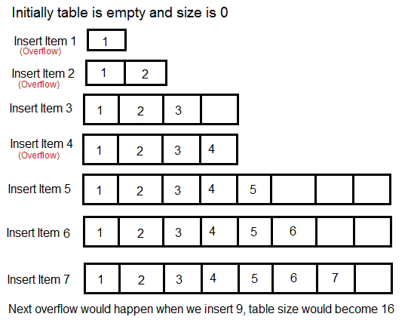
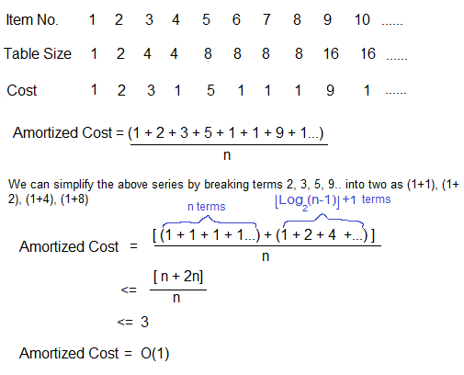

Slide 44
The solution to this trade-off problem is to use Dynamic Table (or Arrays). The idea is to increase size of table whenever it becomes full. Following are the steps to follow when table becomes full. 1) Allocate memory for a larger table of size, typically twice the old table. 2) Copy the contents of old table to new table. 3) Free the old table.
If the table has space available, we simply insert new item in available space.

Slide 45
What is the time complexity of n insertions using the above scheme?
If we use simple analysis, the worst case cost of an insertion is O(n). Therefore, worst case cost of n inserts is n * O(n) which is O(n²). This analysis gives an upper bound, but not a tight upper bound for n insertions as all insertions don’t take Θ(n) time.

Slide 47
So using Amortized Analysis, we could prove that the Dynamic Table scheme has O(1) insertion time which is a great result used in hashing.
Following are few important notes.
1) Amortized cost of a sequence of operations can be seen as expenses of a salaried person. The average monthly expense of the person is less than or equal to the salary, but the person can spend more money in a particular month by buying a car or something. In other months, he or she saves money for the expensive month.
2) The above Amortized Analysis done for Dynamic Array example is called Aggregate Method. There are two more powerful ways to do Amortized analysis called Accounting Method and Potential Method.
3) The amortized analysis doesn’t involve probability. There is also another different notion of average-case running time where algorithms use randomization to make them faster and expected running time is faster than the worst-case running time. These algorithms are analyzed using Randomized Analysis. Examples of these algorithms are Randomized Quick Sort, Quick Select and Hashing.

Slide 48
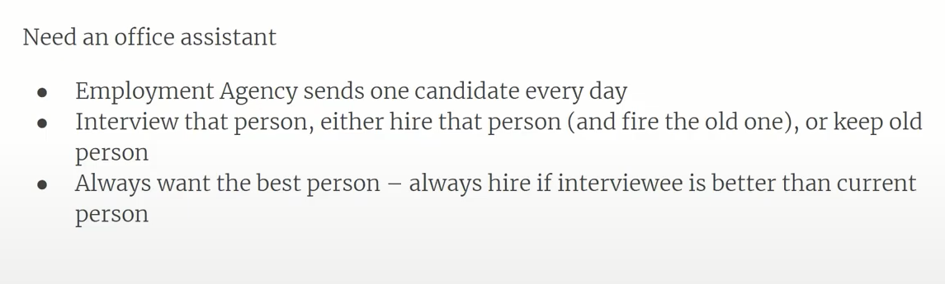
Probabilistic Analysis
Hiring Problem

Slide 49
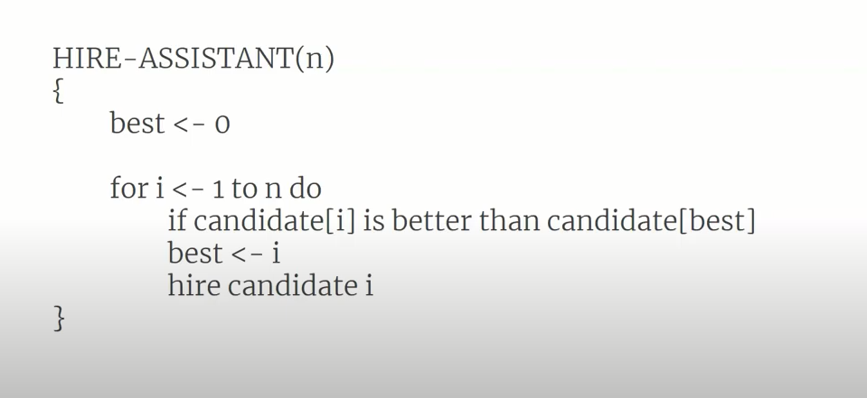
Hiring Problem

Slide 50
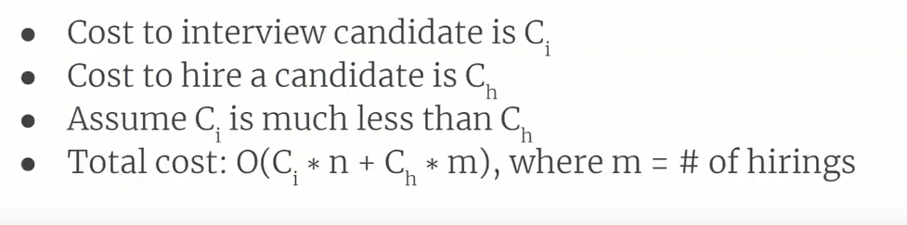
Hiring Problem

Slide 51
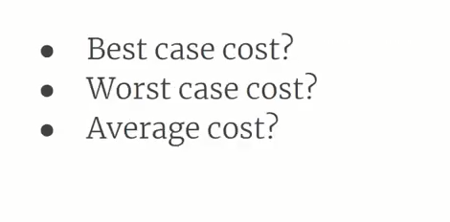
Hiring Problem

Slide 52
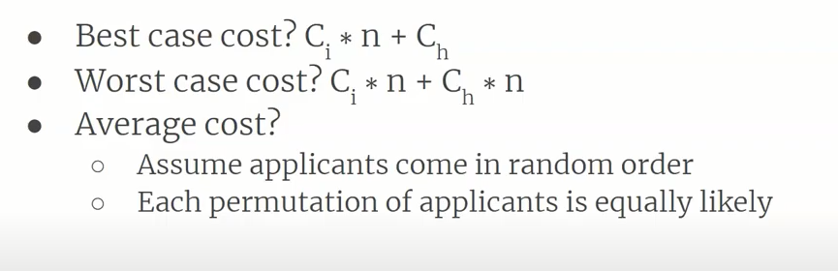
Hiring Problem

Slide 53
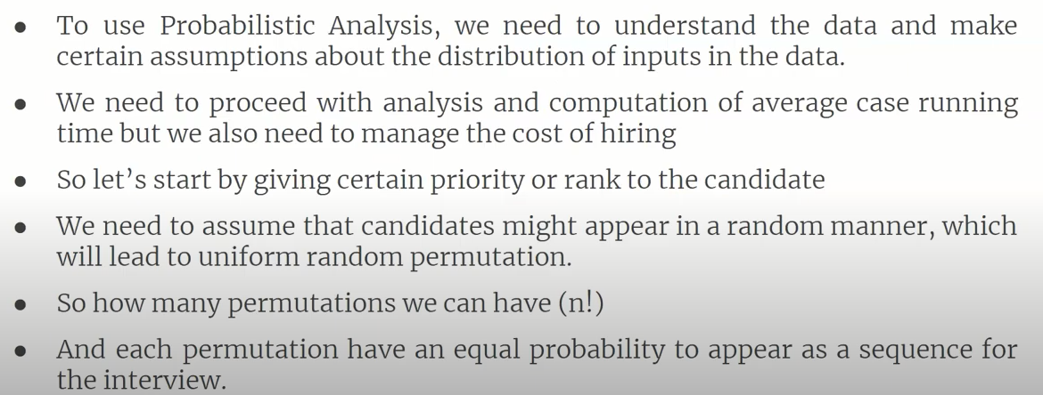
Probabilistic Analysis

Slide 54
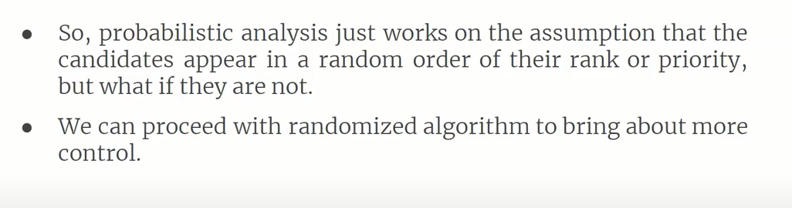
Probabilistic Analysis

Slide 55
T(n)= a + T(n-1) (1) n=1, c>0 n>1
T (n-1)= T(n-2)+a (2)
T(n)= T(n-2)+ 2a ---3
T(n-2)= T(n-3)+a ----4
T(n)= T(n-3)+3a
……
……..
T(n)= T(n-k)+ ka ------- T(n)= T(1)+ (n-1)a----- c+an-a------ T(N)= O(n)
n-k=1----- k=n-1

Slide 56
Amortized analysis
Algo -----sequence of operations for executed
______________{ slow }______________________

